Slide 1
HOW MUCH DOES WHERE YOU LIVE AFFECT WHERE YOU GO AND HOW YOU FEEL? A STUDY OF OLDER PEOPLE IN NORTHERN ENGLAND
‘WS-04 Housing and living conditions of ageing populations’
ENHR 2014, Edinburgh, 2nd-4th July
Delivered 3rd July
Rebecca Tunstall, Karen Croucher, Mark Bevan, David Swallow (University of York), Rose Gilroy (University of Newcastle), Moyra Riseborough (freelance)
Becky.tunstall@york.ac.uk
01904 321 474

Slide 2
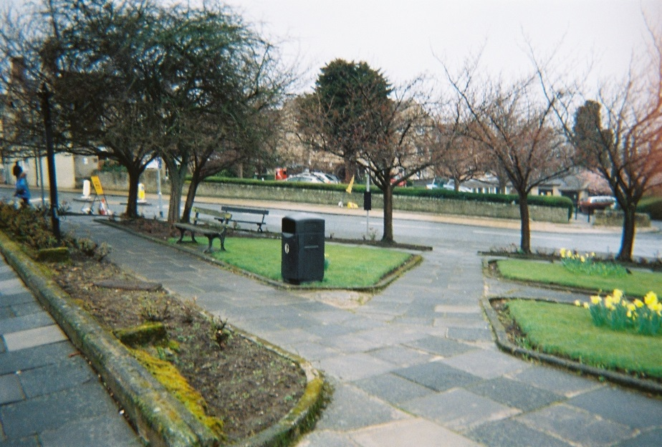
“Now this is a plus! We’ve got a little rose garden… I often sit there when I’m paddling down to the hospital” (HEX1 Photo 28).

Slide 3
The Co-Motion project
Data presented here collected as part of ‘Co-Motion’ project lead by the University of York, with University of Leeds, Newcastle and Northumbria, 2013-16
Longitudinal study of older people + development of practical tools to support mobility and wellbeing
Involves social policy, gerontology, geography, psychology, transport studies, computer science
One of 7 projects supported by EPSRC/ESRC/AHRC’s ‘Design for Wellbeing: Ageing and mobility in the built environment’ programme.
More info: www.york.ac.uk/media/chp/documents/co-motion/Case%20for%20support.%20docx.pdf

Slide 4
Research questions
How much are mobility and wellbeing related?
How much do mobility and wellbeing vary by city, neighbourhood and micro-neighbourhood?
How much of this variation can be attributed to characteristics of the city, neighbourhood and the micro-neighbourhood of the home (as opposed to individual characteristics or other factors)?
What characteristics of the city, neighbourhood and the micro-neighbourhood of the home appear to promote and inhibit mobility and wellbeing?

Slide 5
Project hypotheses (1)
mobility
wellbeing

Slide 6
(2)
environments
wellbeing

Slide 7
(3)
environments
wellbeing
mobility

Slide 8
Study data and methods
1) National contextual interviews
3 case study sites:
2) Local contextual interviews
3) Sample of c120 people aged 55+ in case study sites, experiencing one or more of the following key life ‘transitions’ in the past year:
Stopping work;
Starting/stopping being a carer (for an adult) or significant childcare responsibility (1 day+/week);
Starting to use a mobility scooter or other mobility aid;
Stopping driving;
Significant loss of sight or hearing;
Starting to live on their own.
- physical and social transitions more significant than chronological age (Grenier 2012)

Slide 9
Concepts and measures used (1)
‘Wellbeing’:
Bowling’s Older Person’s Quality of Life questionnaire (OPQOL)
Office for National Statistics’ 4 questions
Participants’ own definitions
‘Mobility’ :
Potential mobility (access to a car or van; income)
Potential mobility (distance can walk without break on a good day/bad day, regular use of mobility aids, limiting health condition/disability, self-rated health)
Actual mobility (furthest distance travelled yesterday/last week/last year)
Mobility against aspirations (‘I can get to the places I want to go to’)
Salience of mobility (‘It’s important for me to get out and about’)
Participants’ own definitions

Slide 10
Concepts and measures used (2)
‘Environments’:
1) Case study city
2) Neighbourhood
Satisfaction with area
Answers to OPQOL questions:
‘I feel safe where I live’
‘The local shops and services are good overall’
‘I find my neighbourhood friendly’
Deprivation (LSOA)
(Will explore further variables including travelability)
3) Home
Satisfaction with home
Housing tenure
Answer to OPQOL question ‘I get pleasure from my home’

Slide 11
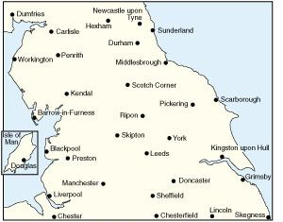
Case study sites
Leeds, York, Hexham
Varied in population size (750,000; 200,000; 12,000), demographics (15%, 17%, 23% 65+), deprivation, built environment

Slide 12
Work with c120 older people
Initial ‘pen and paper’ self-completion questionnaire, incorporating OPQOL, mobility, and socio-economics;
Semi-structured face to face interviews exploring the same issues in more detail and also discussing the impact of the transition participants have experienced;
(sub-group of c20) photo project involving participants taking photos of things in their environment that affect mobility or wellbeing, with captions and commentary recorded;
Every 3 months, telephone interviews monitoring changes over time, covering mobility, wellbeing using ONS questions (Powell 2014), other changes;
After a total time of c18 months, a closing pen and paper questionnaire and face to face interview.

Slide 13
Data reported here
51 initial ‘pen and paper’ questionnaires;
Sample broadly representative of people 55+ in England (age, gender, ethnicity, car ownership, housing tenure); but slightly less married, more healthy
Not full multi-variate analysis to date
4 semi-structured face to face interviews – illustrative only;
4 photo projects (by the same participants).

Slide 14
Results (1): Strong correlations between some mobility measures and OPQOL wellbeing
Physical ability:
Limiting condition/disability
Self-rated health
Distance can walk on a good day
‘I am healthy enough to get out and about’
Mobility against aspirations:
‘I can get to the places I
want to go to’
NOT strong: Access to high mobility technology; Actual mobility
wellbeing
mobility

Slide 15
Illustrative participant comments:
“Twice a year, I meet a friend in Windermere. And that’s important because I really love the drive” (HEX 1)
“After the first week [after his wife had a stroke] we asked for the wheelchair, got the wheelchair and were out. Sometimes twice a day. Because it was such a glorious summer” (HEX2)
“I love to go into York and walk… I just love to be out and about” (YORK 14).

Slide 16
Results (2): Strong correlation between one mobility measure and one environment measure
environment
‘The shops and services are good overall’
‘I can get to the places I want to go to’
NOT strong: Other mobility measures; city, other neighbourhood measures, home measures
?Explore more quantitative and qualitative measures of environment?
mobility

Slide 17
Illustrative participant comments:
“It’s an ideal place to live for the town” (HEX5).
“It would be a help if public transport went where you wanted it to go” (HEX1).
“by and large, people in this town are very very helpful, they’re aware of my limitations [he has cerebral palsy and uses a wheelchair or scooter], and don’t put me in situations where there’s going to be problems. Maybe I’m lucky living in a place like this, I don’t know” (HEX2).
“It’s a 4-inch drop kerb. Well if I’d gone over that it would have tipped the scooter over” [Interviewer: Does it put you off visiting the area?’ “No” (HEX2).
“I choose not to go into York on Saturdays” (YORK14).

Slide 18
Inhibitory features of (pedestrian/scooter/wheelchair) micro environments
Participant comments:
Uneven surfaces on roads and pavements
Slippy surfaces
Sharp edges (which could damage scooter tyres)
No pavements
Non-dropped kerbs
Steep slopes
Steps into shops
Parking on pavements
Obstruction of pavements by adverts, goods, shoppers, parked bikes, bins
Cyclists on pavements
ie Environmental; managerial, social implications

Slide 19
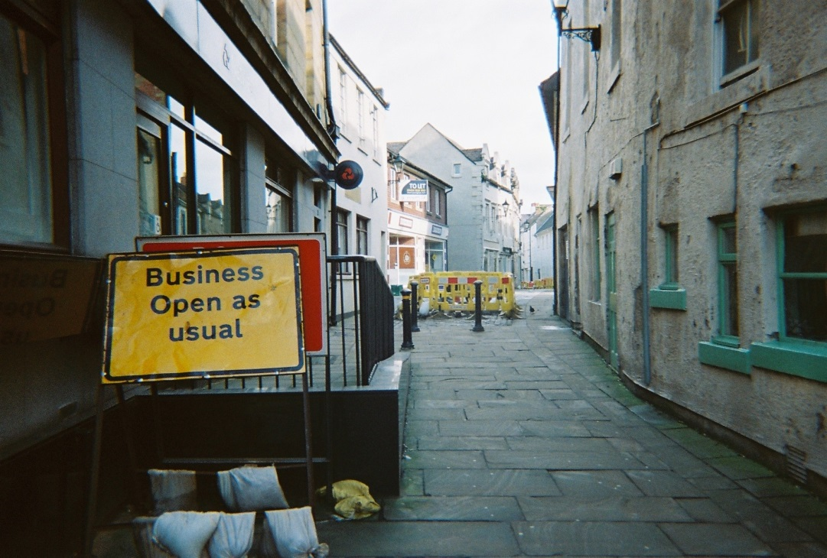
“there was no way we could go along [with a wheelchair]. It was just impossible. They’d left a way – ‘businesses open as usual’ – there was absolute uproar about that! As usual they did something and went away for a few days and came back” (HEX5 Photo 5)

Slide 20
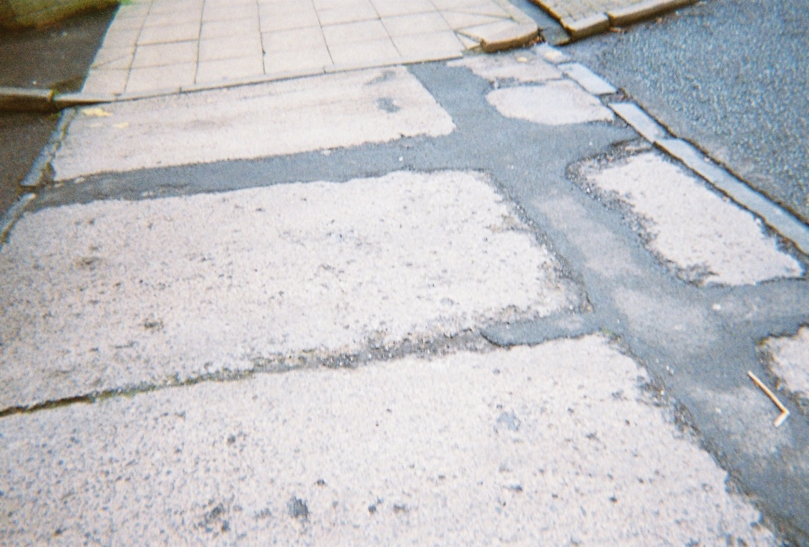
“It’s just a bad job. They’ve done it without thinking about pedestrians, just to fill a hole” (HEX1 Photo2)

Slide 21
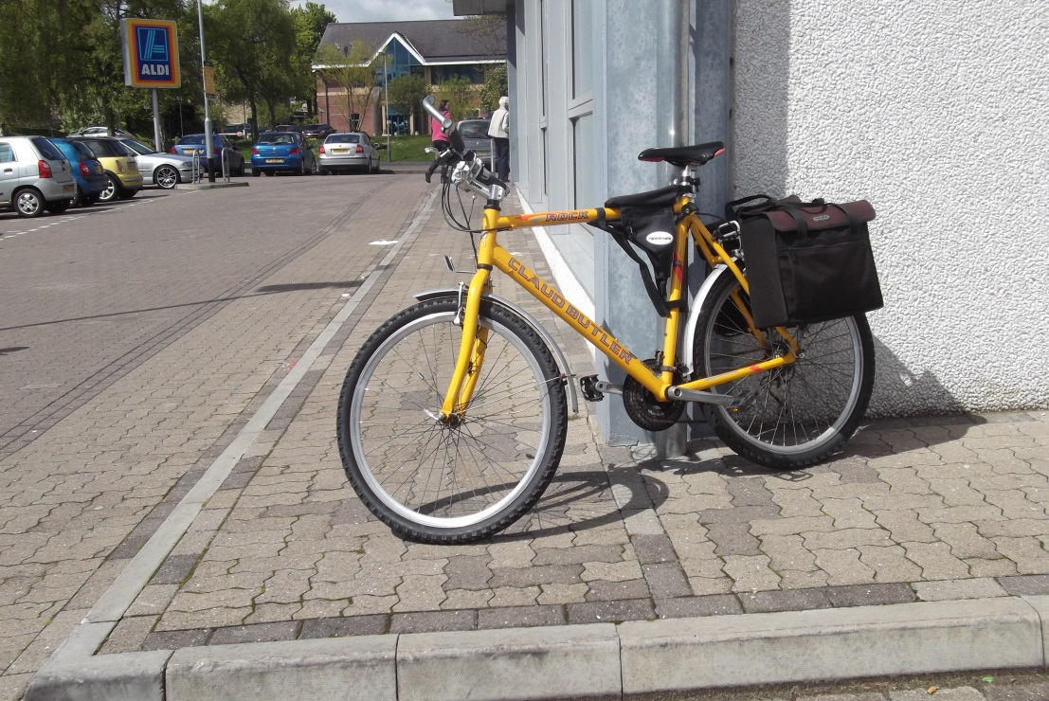
“Another thoughtless cyclist” (HEX 2 Photo 8).

Slide 22
Encouraging/enabling features of (pedestrian/scooter/wheelchair) micro environments
Participant comments:
(Nearby) destinations ie urban density; minimum level of services
Stop-offs ie seats, attractive mini-sites
Pass-bys
Places with meaning ie longer-term residence
Supportive/understanding communities; public transport services
ie Environmental, economic, social implications

Slide 23
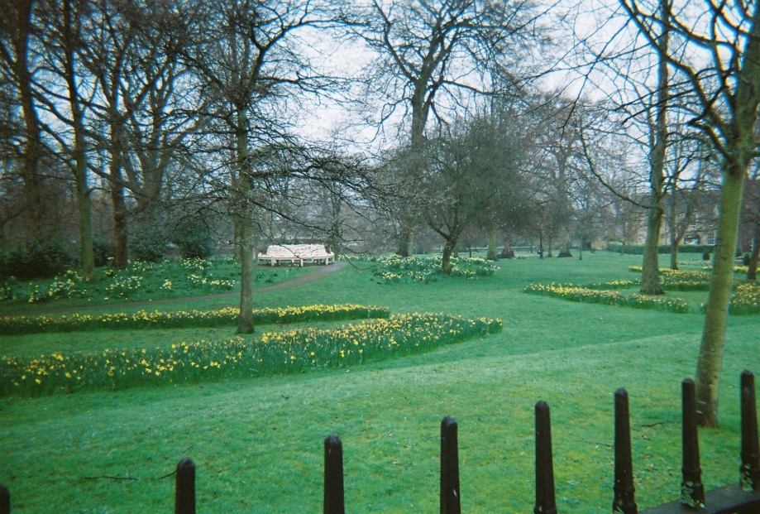
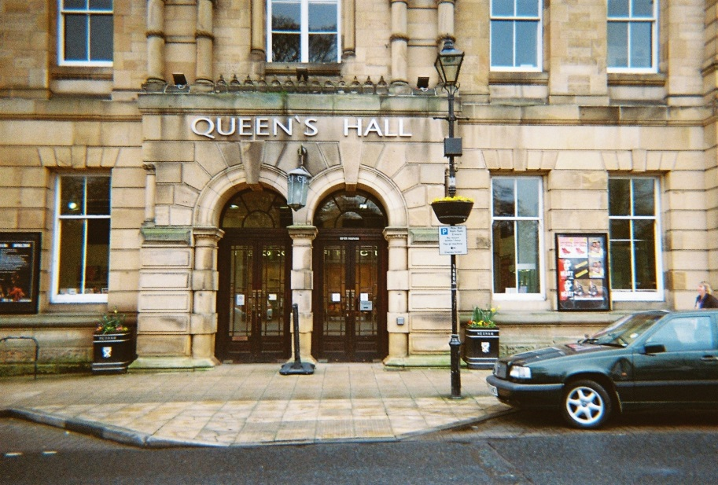
“This is a favourite place of ours [Queen’s Hall library and coffee shop]”] (HEX 5 Photo 10).

Slide 24
“it’s just a very nice area for the town. And very important to us [participant and partner] when going out” (HEX 5 Photo 11).

Slide 25
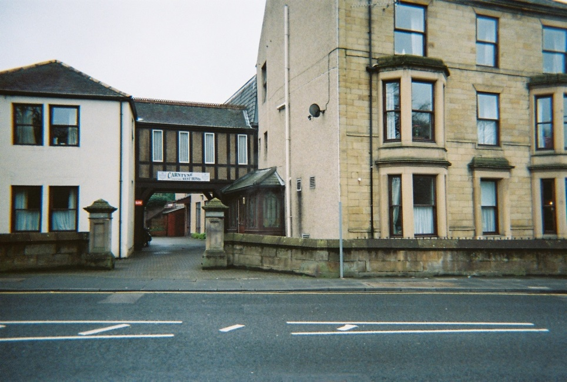
“This, where I went to school, is the convent… and this is the nursing home… so it’s memories for me, and it’s got modern memories as well because people we know are in there” (HEX 5 Photo 12).

Slide 26
Results (3): Strong correlations between some environment measures and OPQOL wellbeing
environments
wellbeing
NOT
‘The local shops and services are good overall’
‘I find my neighbourhood friendly’
NOT strong: City, satisfaction with area, ‘I feel safe where I live’, deprivation, satisfaction with home, housing tenure, ‘I get pleasure from my home’

Slide 27
Summary and implications
environments
wellbeing
mobility

Slide 28
Strong correlations between wellbeing and self rated health, limiting condition/disability, pain; Weak correlations with age, gender, income, employment, marital status + Other factors unknown!
environments
wellbeing
mobility

Slide 29
Strong correlations between wellbeing and self rated health, limiting condition/disability, pain; Weak correlations with age, gender, income, employment, marital status + Other factors unknown!
environments
wellbeing
Strong correlations between mobility (‘I can get to the places where I want to go’) and self rated health, limiting condition/disability; Weak correlations with age, gender, income, employment, marital status; + Other factors unknown!
mobility

Slide 30
Summary of answers to questions to date
a) How much are mobility and wellbeing related?
They are related – but not necessarily strongly – varies by measure; health is an important mediator; numerous other factors including individual socio-economics appear to be are important
b) How much do mobility and wellbeing vary by city, neighbourhood and micro-neighbourhood?
They do vary substantially – but…
c) How much of this variation can be attributed to characteristics of the city, neighbourhood and the micro-neighbourhood of the home?
…again, health is an important mediator; numerous other factors including individual socio-economics appear to be important
d) What characteristics of the city, neighbourhood and the micro-neighbourhood of the home appear to promote mobility and wellbeing?
If people can say ‘the local shops and services are good overall’, ‘I find my neighbourhood friendly’; there are attractive accessible destinations, stop-offs and pass-bys, well-planned and maintained pedestrian/scooter/wheelchair environment.
Further data and analysis pending.

Slide 31
Design for Wellbeing programme hypothesis on potential practical implications…
environments
wellbeing
mobility

Slide 32
Co-Motion project hypothesis on potential practical implications…
environments
wellbeing
mobility

Slide 33
Practical implications to date (1)
Environmental means that might a) improve wellbeing b) encourage/enable mobility and thus wellbeing:
Attractive accessible destinations, stop-offs and pass-bys
Well-planned and maintained pedestrian/scooter/wheelchair environment.
Some immediate improvements identified for case study sites (generalizable to others) that would please participants
Note: While 32/51 walked ‘daily’ and only 24 drove a car/got lifts daily, car driving/lifts ‘made the most difference to my life’ 27/51 participants; walking for just 6/51. Photo method biased against driving!

Slide 34
Practical implications to date (2)
Non-environmental (social, economic, managerial) means to improving mobility and wellbeing:
Improving self-rated health and reducing limiting conditions/disability
Local shops and services that are ‘good overall’
Neighbourhoods that are ‘friendly’
Attractive accessible destinations, stop-offs and pass-bys.
Further data and analysis pending.

Slide 35
References
Bowling A, and Stenner P. (2011). Which measure of quality of life performs best in older age? A comparison of the OPQOL, CASP-19 and WHOQOL-OLD. Journal of Epidemiology and Community Health, 65:273-280. Open access. doi:10.1136/jech. 2009.087668
Bowling, A (ud) Older People’s Quality of Life Survey (http://www.google.co.uk/url?sa=t&rct=j&q=&esrc=s&source=web&cd=1&ved=0CCAQFjAA&url=http%3A%2F%2Fwww.ilcuk.org.uk%2Ffiles%2Fpdf_pdf_161.pdf&ei=UxiYU7_bCIGkPZfEgKAC&usg=AFQjCNHHuc4FHyqiifxm6vwjgG52lgOeSQ&sig2=foqYEOu7SBejcMEveql4CQ&bvm=bv.68693194,d.ZGU)
Grenier, A (2012) Transitions and the lifecourse: Challenging the constructions of ‘growing old’ Bristol: Policy Press
Powell, M (2014) National wellbeing measures, March 2014 London: ONS

Slide 36
Acknowledgements
We would like to thank our funders, EPOSRC, ESRC and AHRC. We would like to thank all the older people who have given time to the project to date. All the photos shown are theirs.

